Slide 1
Algoritma
Pemrograman 2
Ibu Saniati,S.ST.,M.T.
#2 APA ITU SEARCHING ?

Slide 2
SEARCHING ?
Searching (mencari) adalah kegiatan atau cara memindai data dari kumpulan data.
Notes:
Image source:-
https://pixabay.com/en/technology-industry-big-data-cpu-3092486/

Slide 3
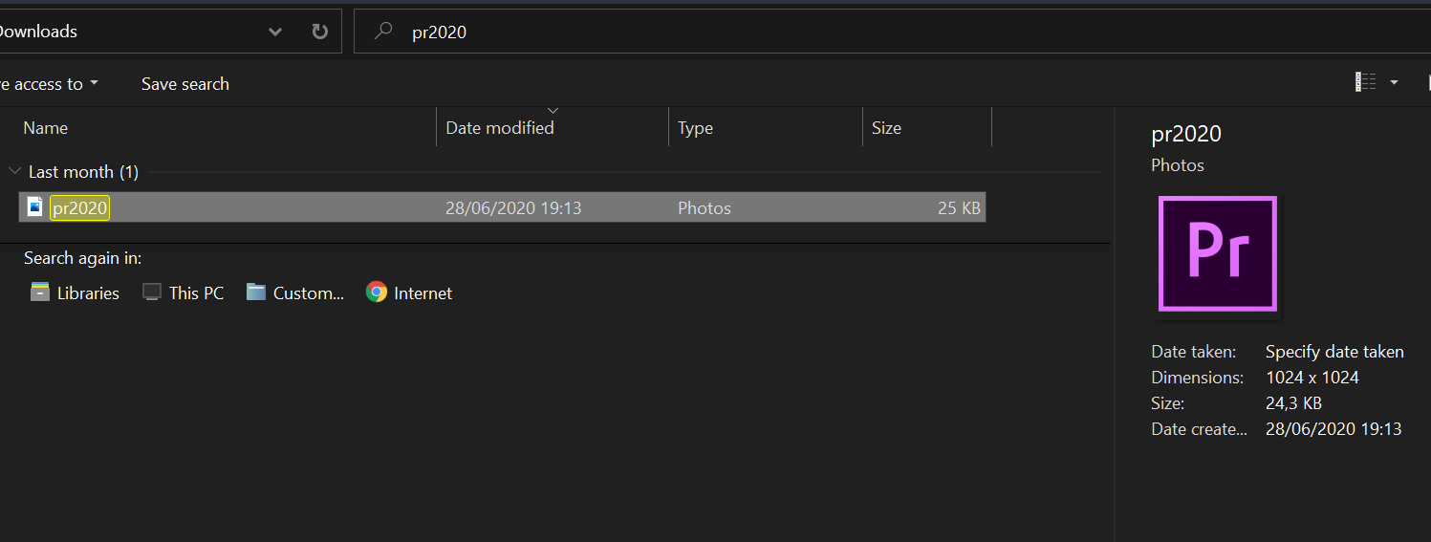
PENGGUNAAN SEARCHING ?
Notes:
Image source:-
https://pixabay.com/en/technology-industry-big-data-cpu-3092486/

Slide 4
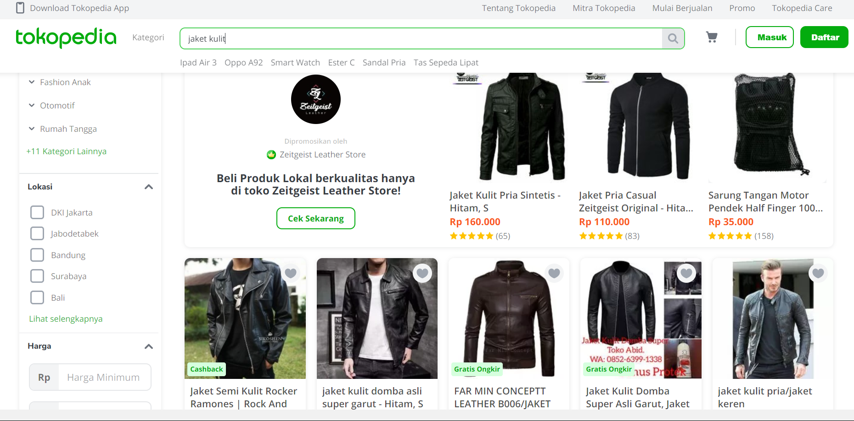
PENGGUNAAN SEARCHING ?
Notes:
Image source:-
https://pixabay.com/en/technology-industry-big-data-cpu-3092486/

Slide 5
JENIS SORTING
05
Searching Algorithm
5.1
Sequential Search
5.2
Binary Search
5.N
Dll..
Notes:
Image source:-
https://pixabay.com/en/technology-industry-big-data-cpu-3092486/

Slide 6

NEXT
#9 SEQUENTIAL SEARCH
Notes:
Image source:-
https://pixabay.com/en/coding-programming-working-macbook-924920/

Slide 7
THANK YOU
KEEP LEARNING & KEEP SPIRITS
Notes:
Image source:-
https://pixabay.com/en/coding-programming-working-macbook-924920/

